Slide 1
Contacts Connect
COP4331 LAMP Stack Project

Slide 2
A web app to manage your digital contacts
Sign up for a contact manager! (It’s FREE!)
Create, Delete, and Edit contacts
Search contacts to find the exact Josh you’re looking for!

Slide 3
Brought to you by…
Joshua Bartz
Eugenio Diaz
Joshua Jarquin
Benjamin Monroy
Gabriel Rechdan
Alejandro Tejeira
(Database)
(API)
(Project Manager)
(Frontend)
(API)
(Frontend)

Slide 4
Built using…
LAMP Stack implementation:
Linux:
Hosted on an Ubuntu 22.04 server rented from DigitalOcean.
Apache (HTTP):
An HTTP web server used to deliver web pages across the internet.
MySQL:
The database solution to store/modify/fetch relevant data.
PHP:
The language used to bridge requests between the website and the database.

Slide 5



Technologies – Project Management
Github:
Repository for source code and documentation
Discord:
Primary platform for communication
GanttPRO:
Gantt chart creation tool to track workflow and timelines

Slide 6
The Good – Project Management
Great communication
Weekly in-person meetings
Frequent status updates via Discord
Friendly relationships
Evenly split workloads
Team ultimately adopted respective technologies

Slide 7
The Ugly – Project Management
Initial adoption of new languages (PHP, CSS, JS)
Working in a real team with task dependencies
Pacing and workflow (late and slow start)
Lack of Gantt chart early on to direct timelines

Slide 8
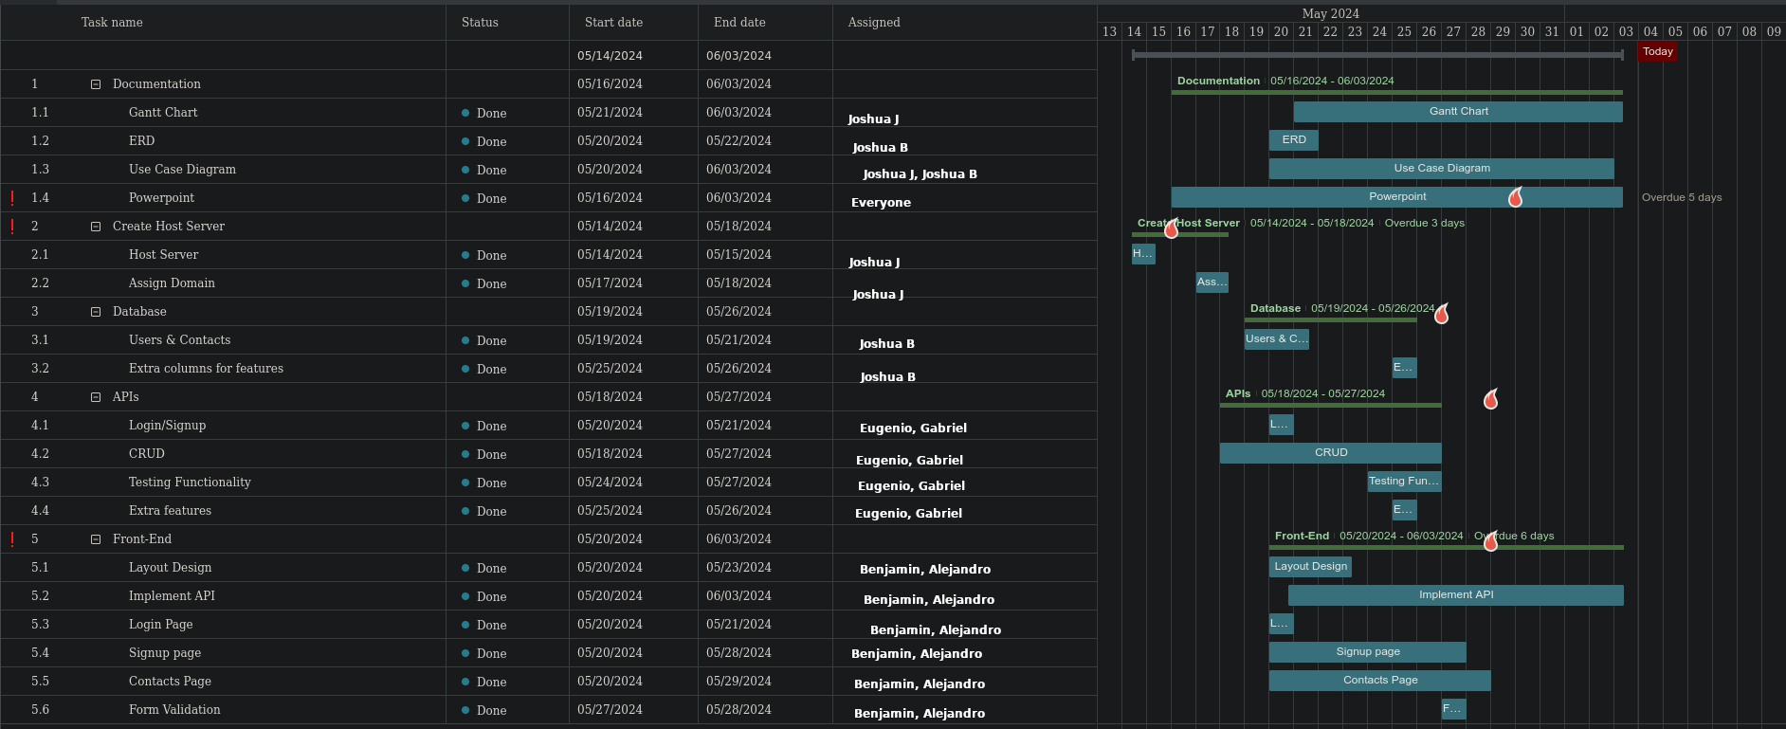
Gantt Chart

Slide 9
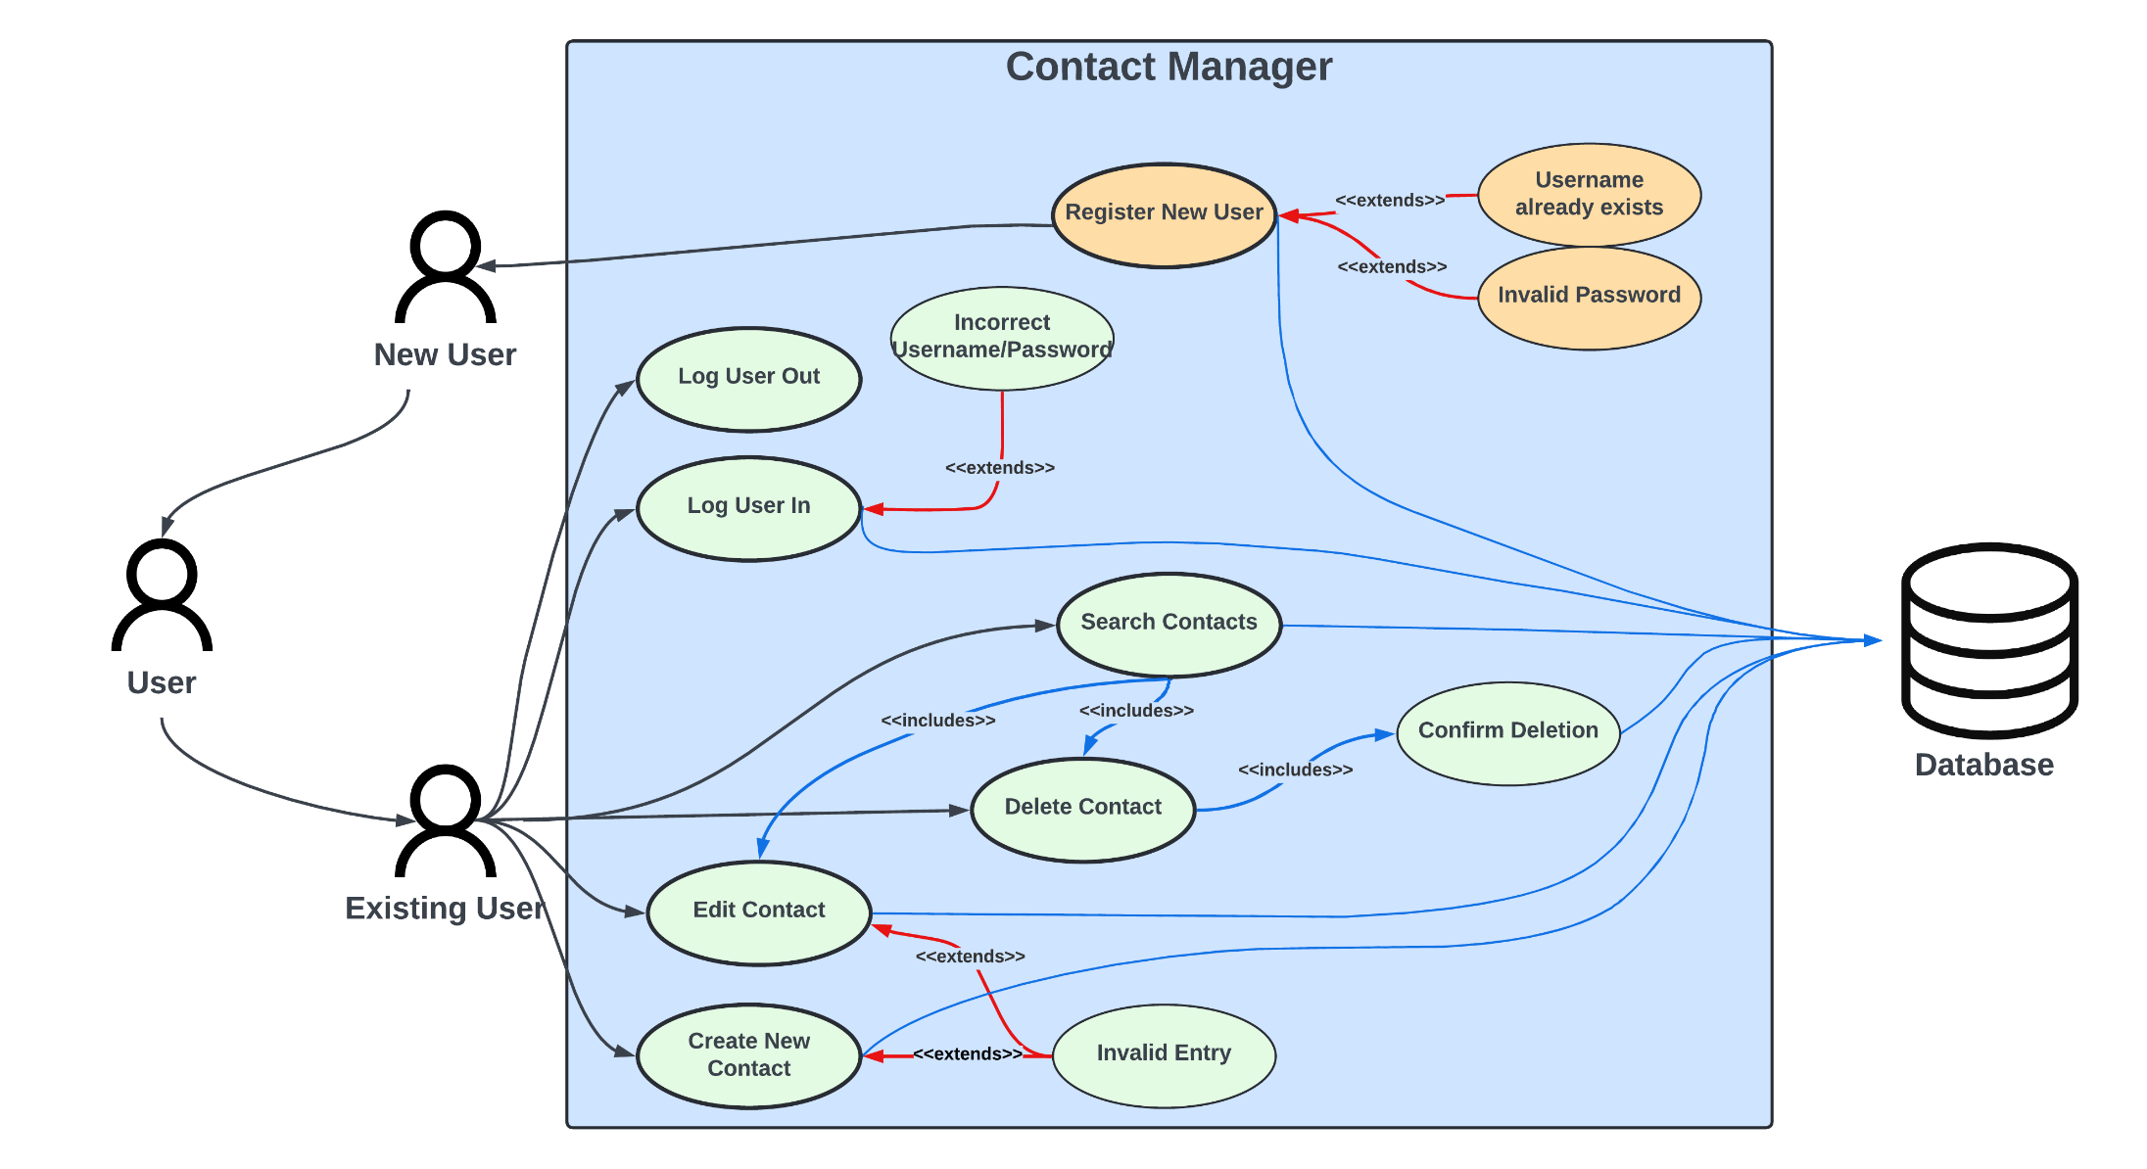
Use Case Diagram

Slide 10


Technologies - Database
PuTTY:
Accessing the database remotely
DBeaver:
Accessing the database remotely

Slide 11
The Good - Database
Previous knowledge of SQL
Rapid adoption of MySQL syntax
Early creation of database
Communication with API team to assist with SQL queries

Slide 12
The Ugly - Database
Attempting to reduce workload of other roles
Avoiding stepping over work of other roles

Slide 13
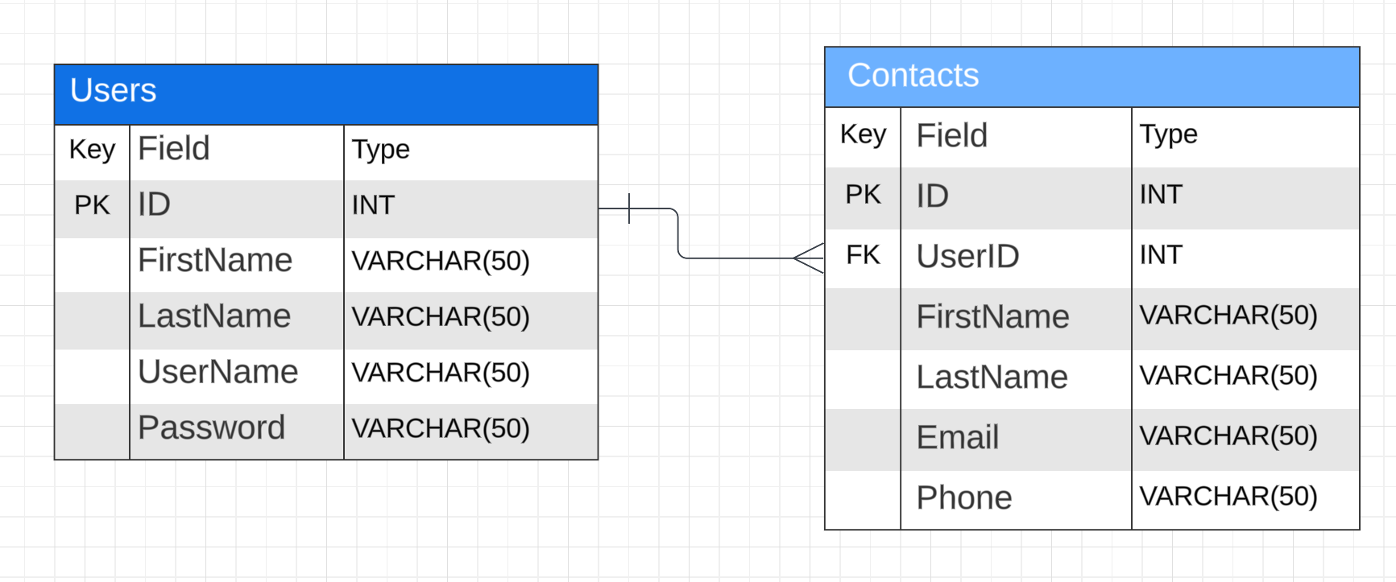
Tabular ERD

Slide 14
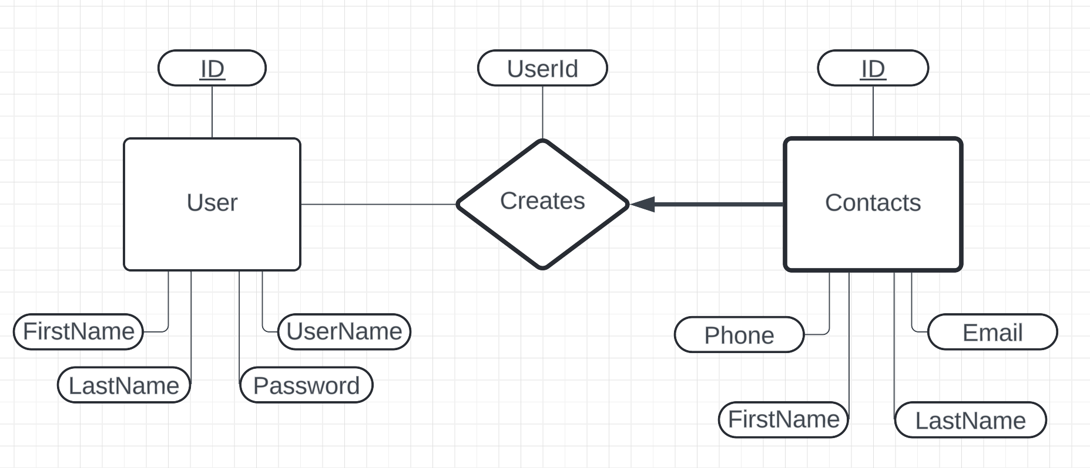
Pictorial ERD with Weak Entity

Slide 15



Technologies - API
Postman:
Initial API endpoint testing
SwaggerHub:
Documentation and thorough endpoint testing
Visual Studio:
Simple editor for PHP files

Slide 16
The Good - API
Snowballed progress after developing an understanding
Getting through the first endpoint led the others to fall into place
Simple and functional documentation
Short testing phase that quickly highlighted issues

Slide 17
The Ugly - API
PHP read like hieroglyphics as beginners
Achieving the initial understanding took time
Variable ordering in MySQL statements led to disproportionate struggle
Despite documentation, API functionality needed more communication

Slide 18
API Demonstration
SwaggerHub

Slide 19



Technologies - Frontend
Bootstrap 5:
Open-source CSS framework
Chrome DevTools
Debugging and optimization
OpenAI DALL-E
Image generation for backgrounds

Slide 20
The Good - Frontend
Plenty of resources to learn HTML/CSS
Good collaboration and division of work

Slide 21
The Ugly - Frontend
Little experience with a large, creative project
Inconsistencies between different ways of accomplishing the same task
Outdated resources
Difficulties pushing to website

Slide 22





Color Palette
White (#ffffff)
Grayish Blue (#9ab8c5)
Light Sky Blue (#87cefa)
Cyan (#155e8b)
Black (#000000)

Slide 23
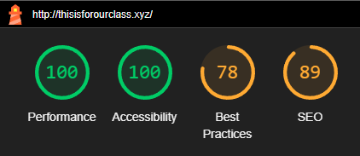
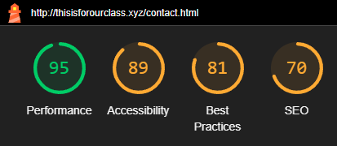
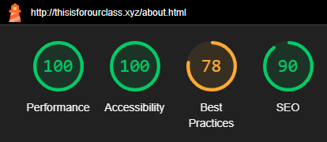
Accessibility via Google Lighthouse
Login and About Pages
Contacts Page

Slide 24
App Demonstration
Contacts Connect

Slide 25
Q&A
Ask away!

